Slide 1
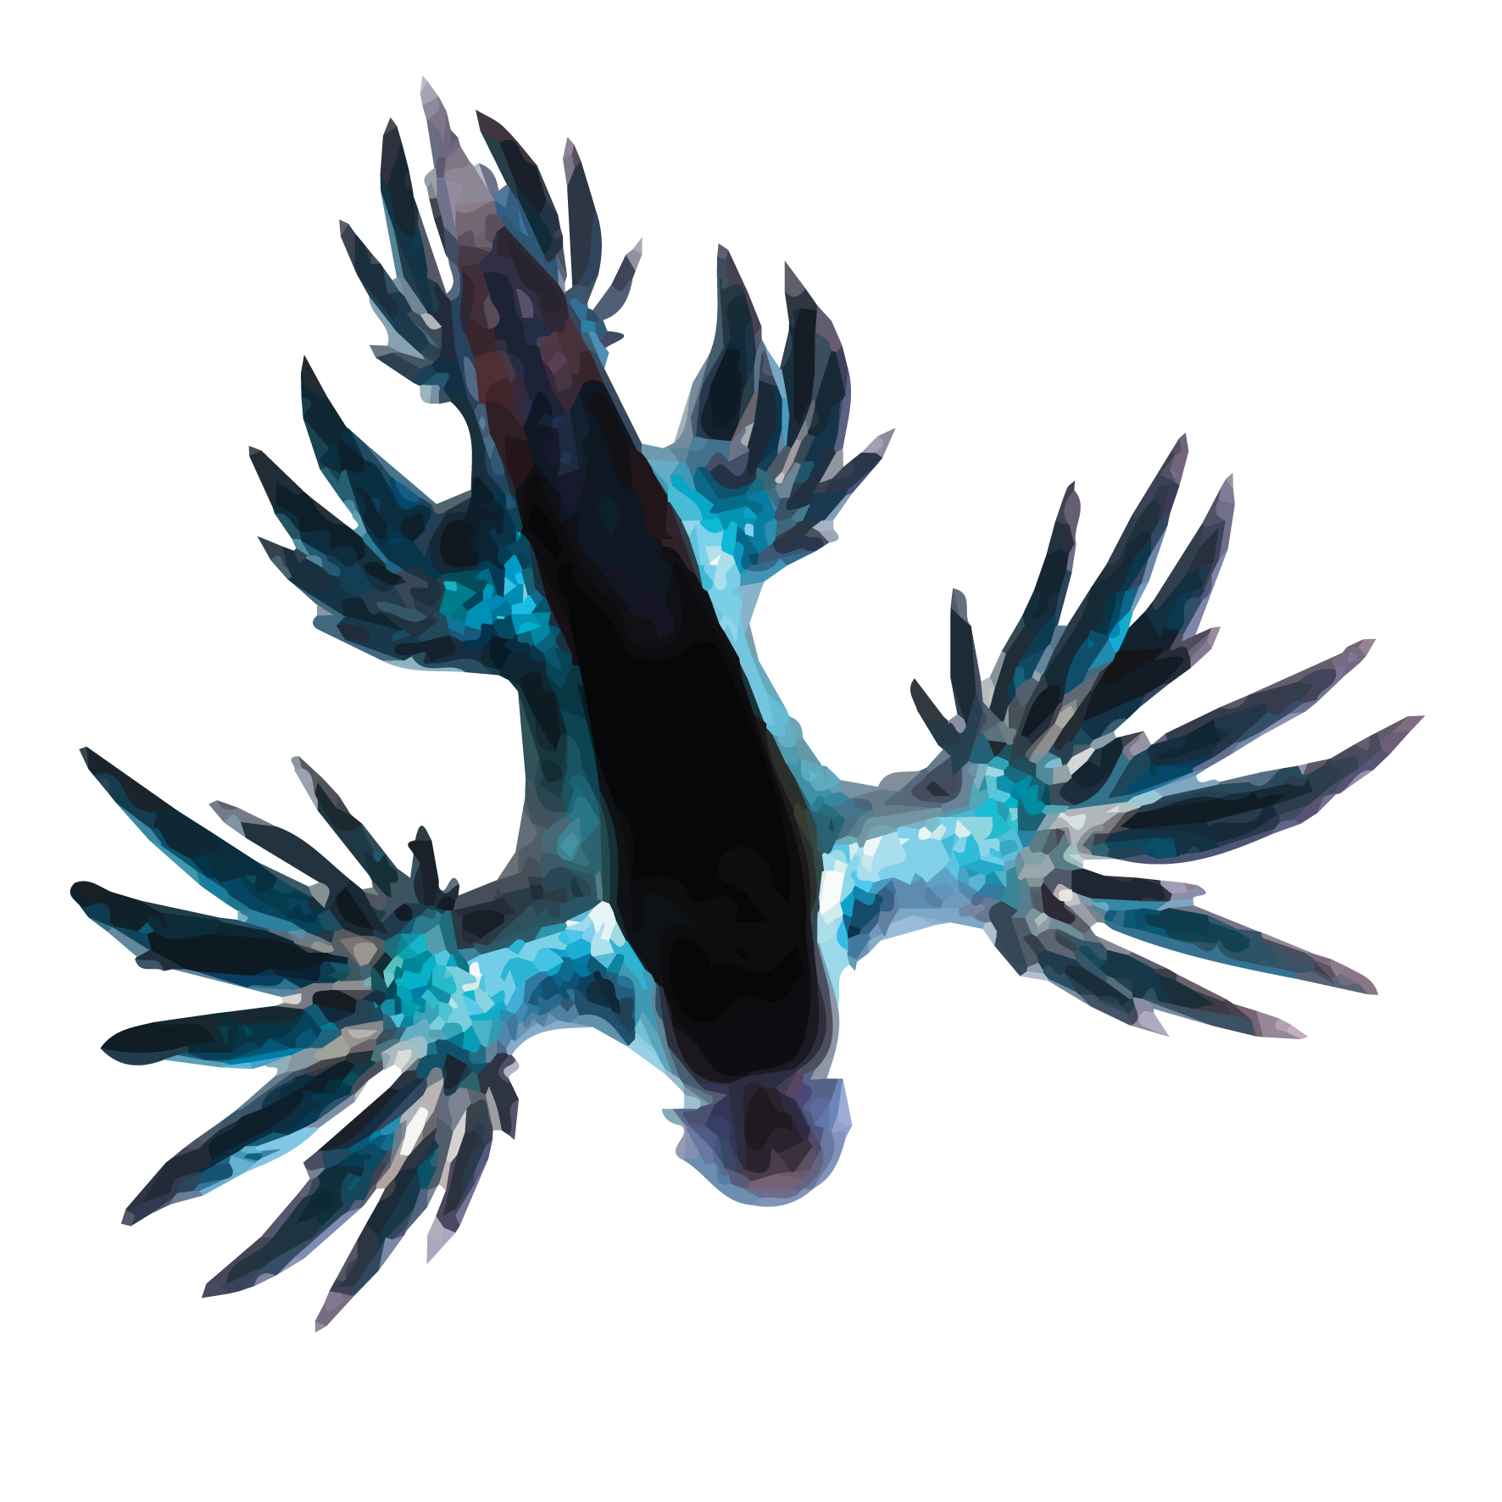
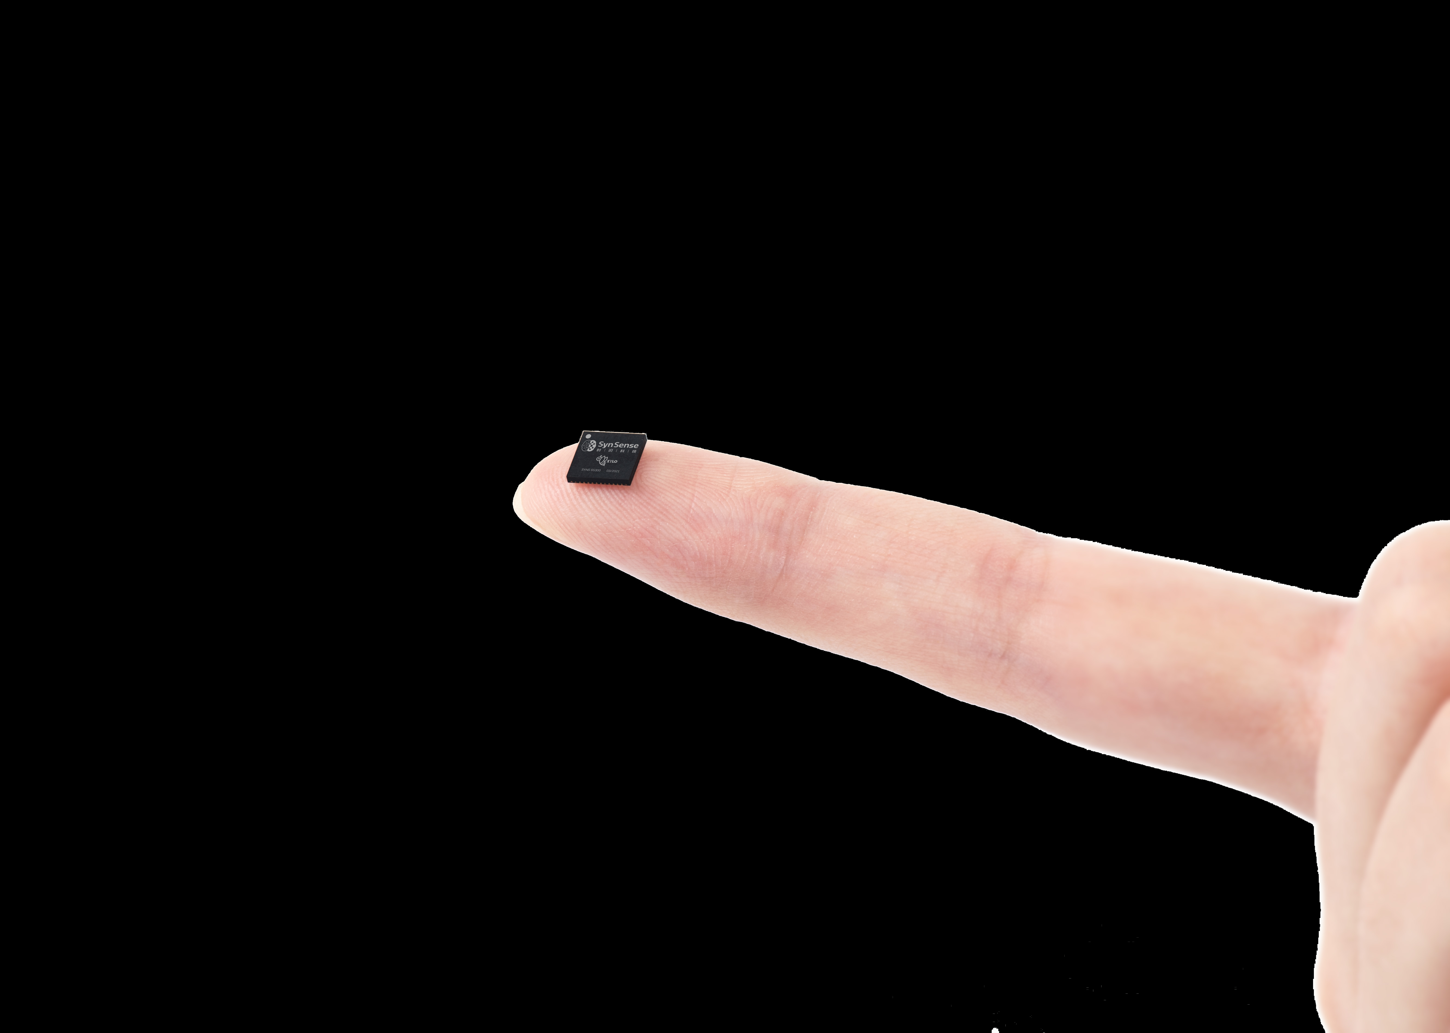
Training and deploying SNN applications with Rockpool and Xylo
OpenNeuromorphic | April 26th 2023
All code: https://github.com/synsense/OpenNeuromorphic_26042023

Slide 2

Hardware / IP / Applications
Ultra-low-power compute
Sensory processing
At the edge

Slide 3


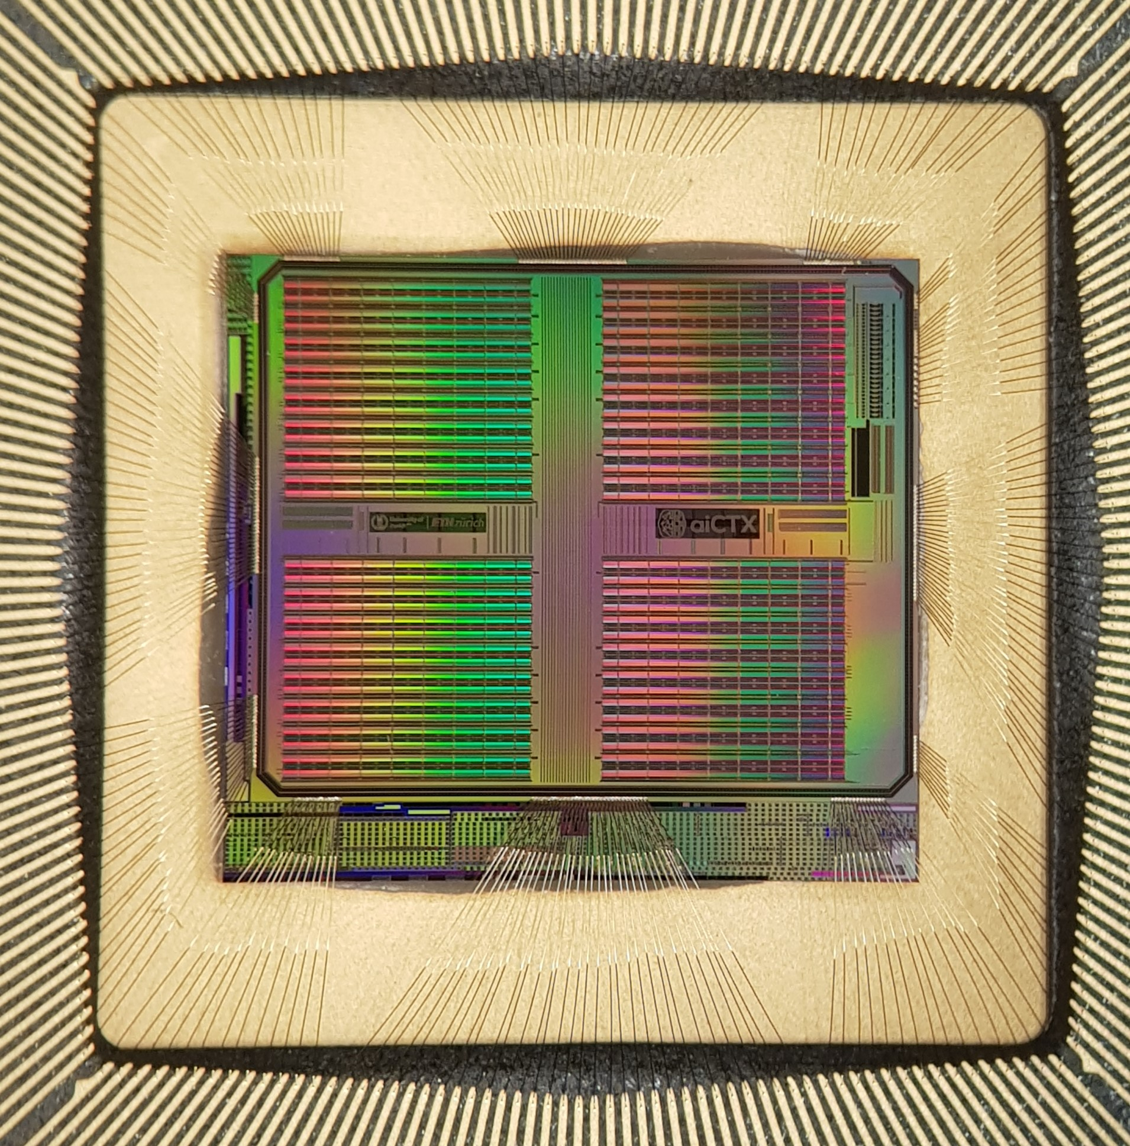



Neuromorphic Smart Sensors
Highly informative output / low bandwidth output
Smart condition detection
Smart wake-up
Continuous monitoring
Low latency → <200 ms
Low power → <10 mW
Notes:
* Our devices are designed to enable smart sensors and smart sensory processing
We are putting compute as close to the sensor as possible, ideally integrated with the sensor itself
We aim to take a high-bandwidth sensor input and produce an extremely sparse, low-bandwidth but highly informative output
For example, smart condition detection, smart wake up, based on vision or audition or other sensors
Our devices operate continuously, should enable real-time latency <200ms, and operate at low power
Low power means <10mW, ideallly much less

Slide 4
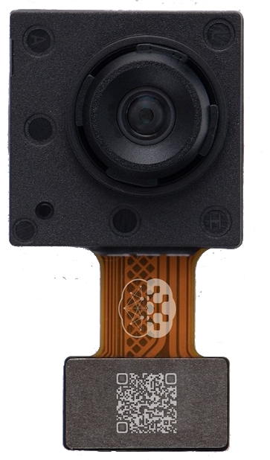
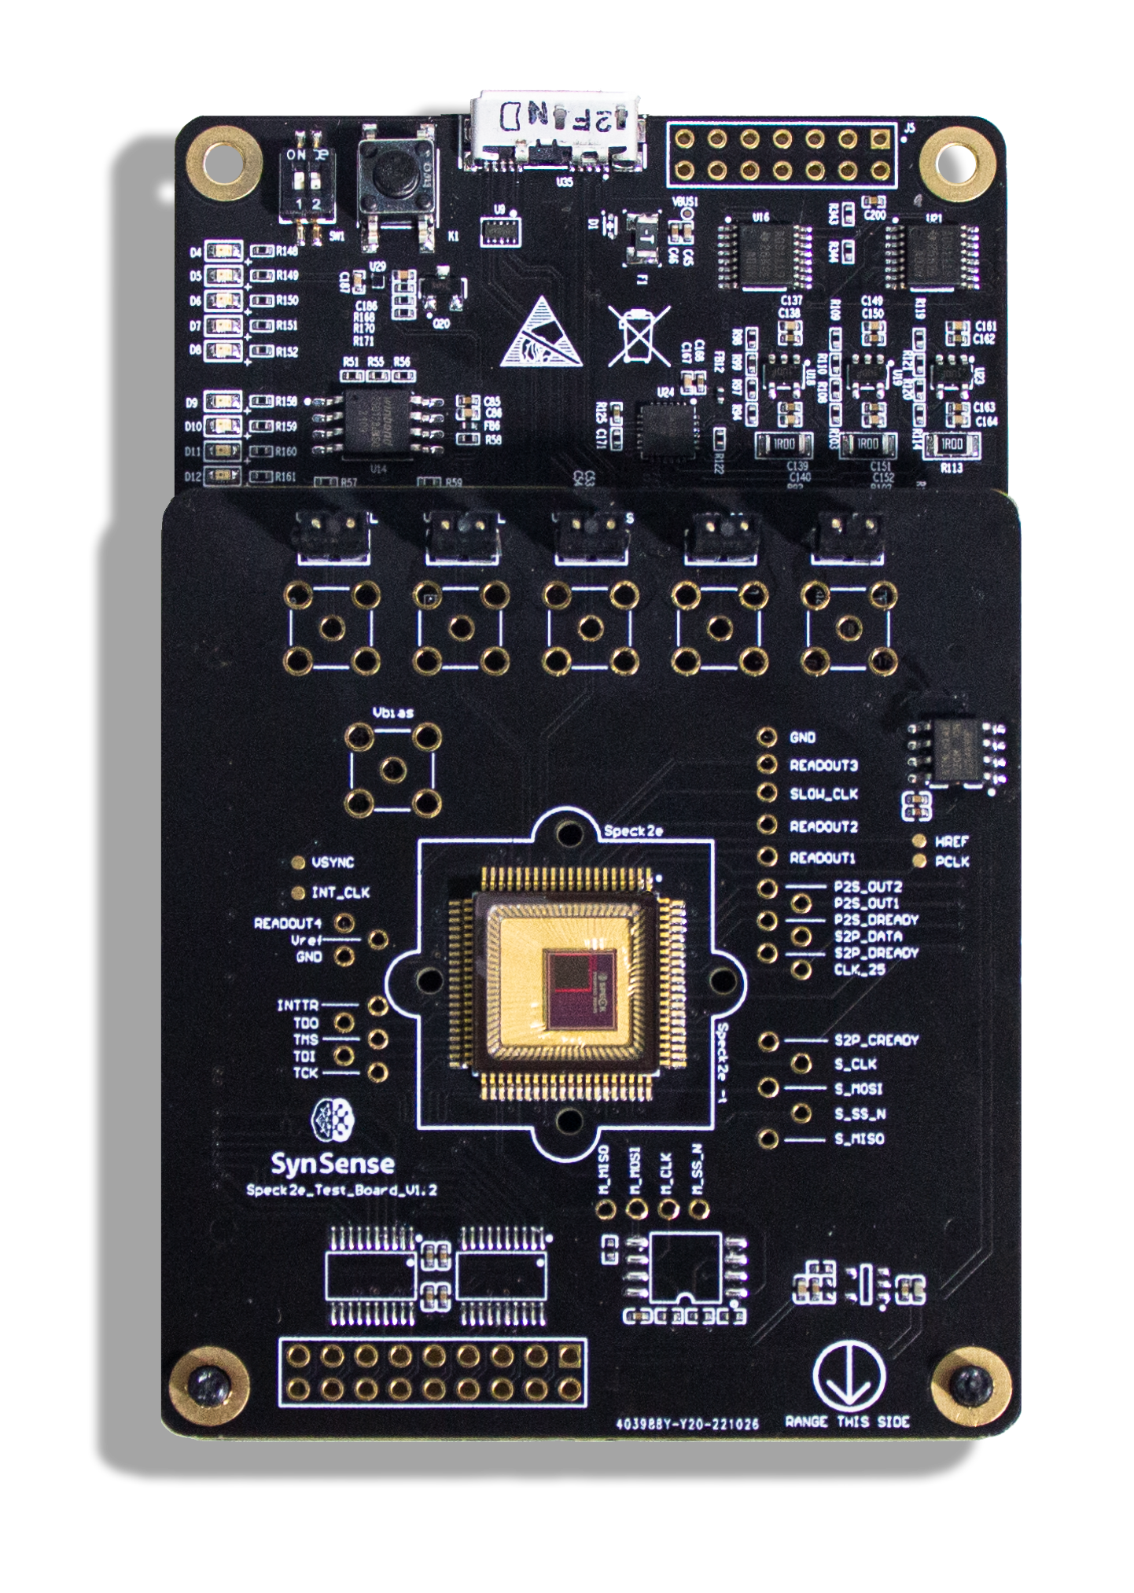
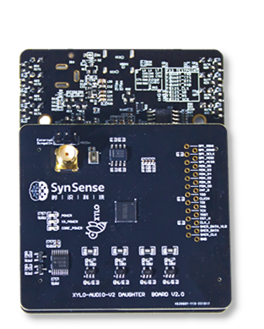
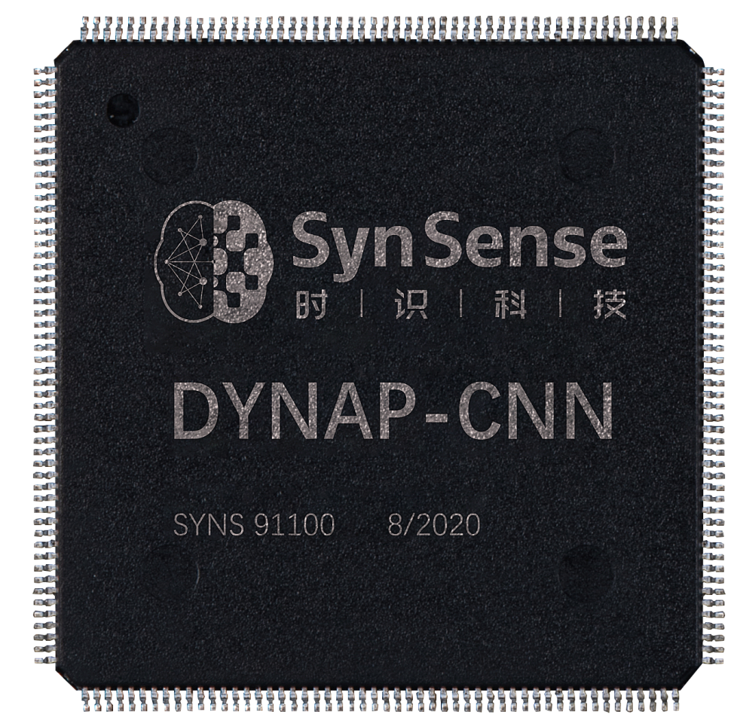
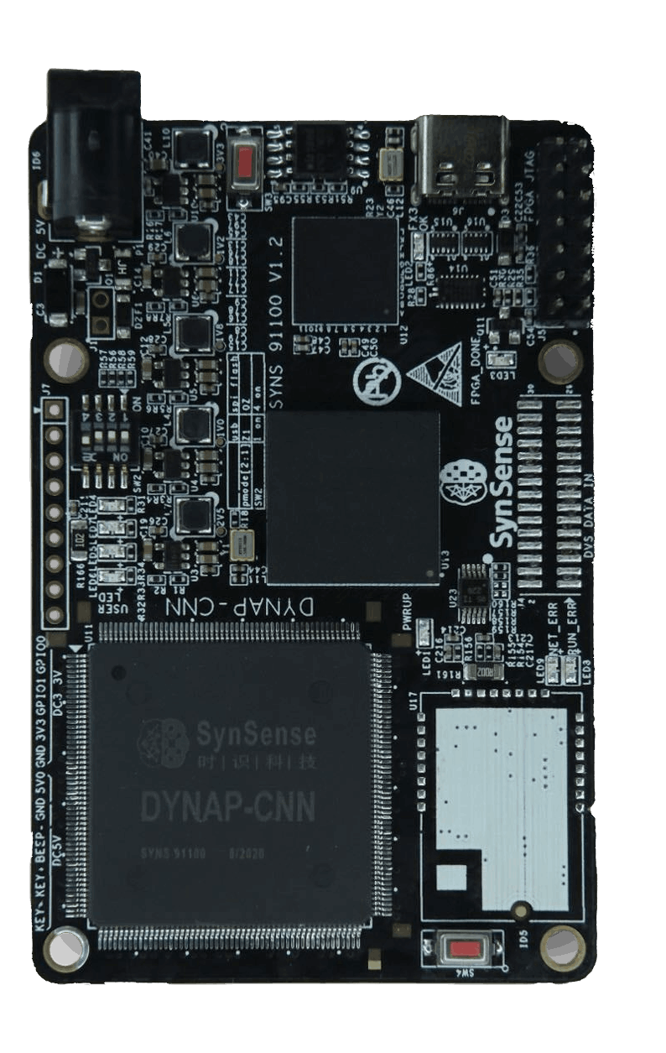
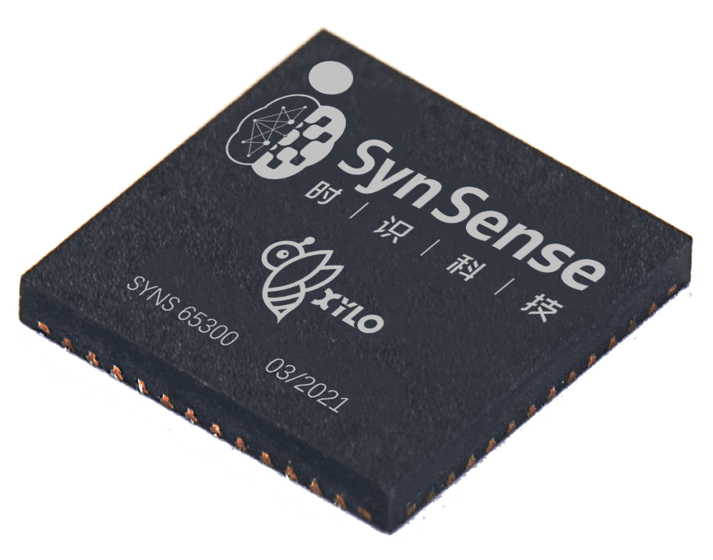
Hardware families
Vision processing with high speed, low power
DynapCNN | Speck
Scalable CNN cores | Integrated vision sensing
Natural signal processing
Xylo
Ultra-low-power
HDK
HDK
HDK
Smart visual wake-up
Object trakcing
Presence detection
Real-time motion estimation
Behaviour detection
Gesture interaction
Audio processing
Bio-signal processing
IMU processing
Condition monitoring
Notes:
Today I’m going to talk about two main device families, for vision processing and natural signal processing, both of which are commercially available this year
DynapCNN and Speck are vision processing devices, based on convolutional networks and spiking neural networks
Speck is a fully integrated SOC, combining a sensor and processor, which I’ll talk about in more detail
Xylo is a family of devices for natural signal processing, designed for sub milliwatt operation, and I’ll also discuss this device in more detail
All these devices have development kits and application toolchains available now

Slide 5
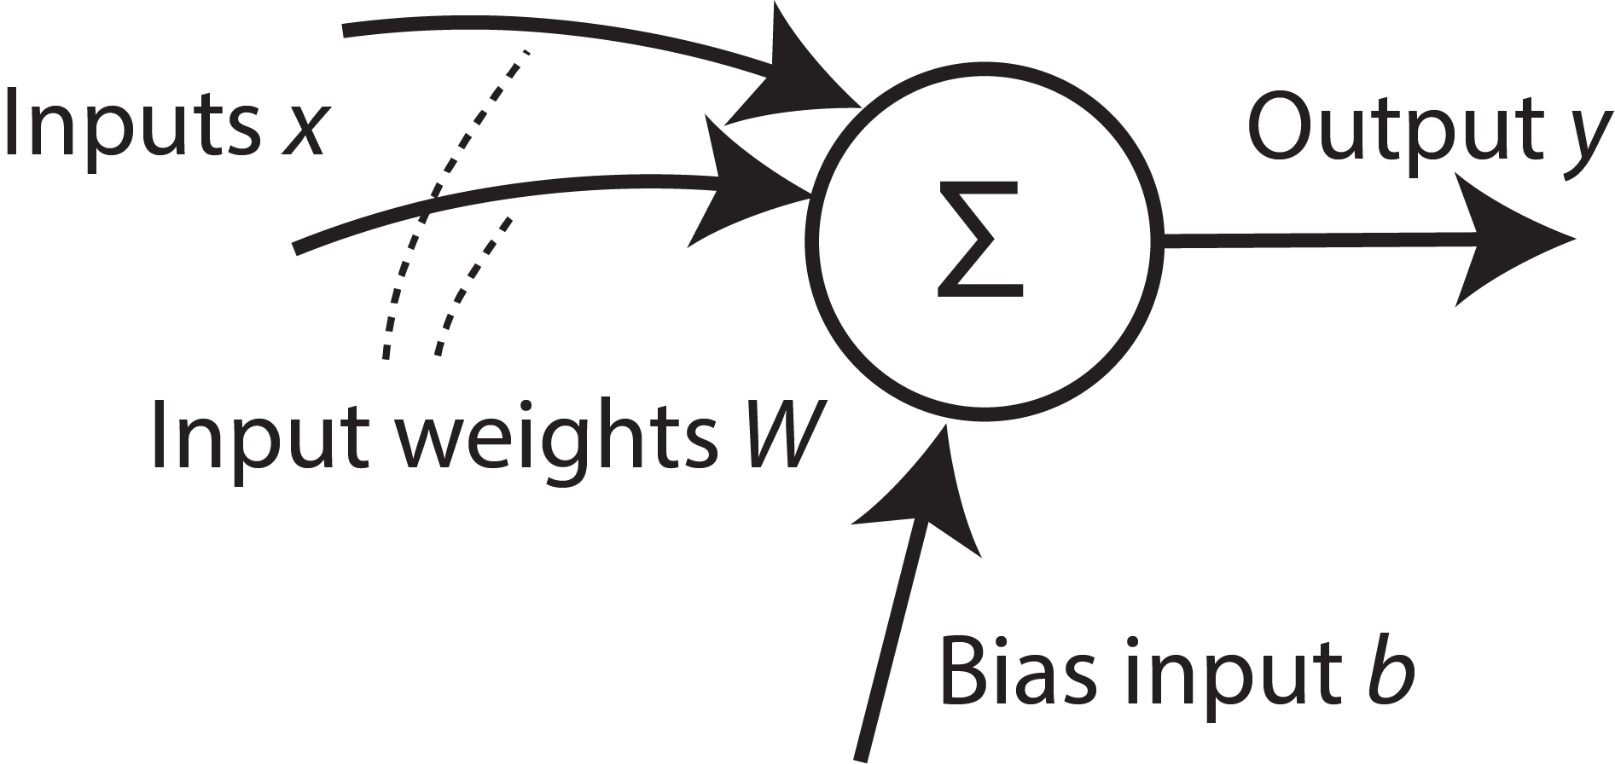
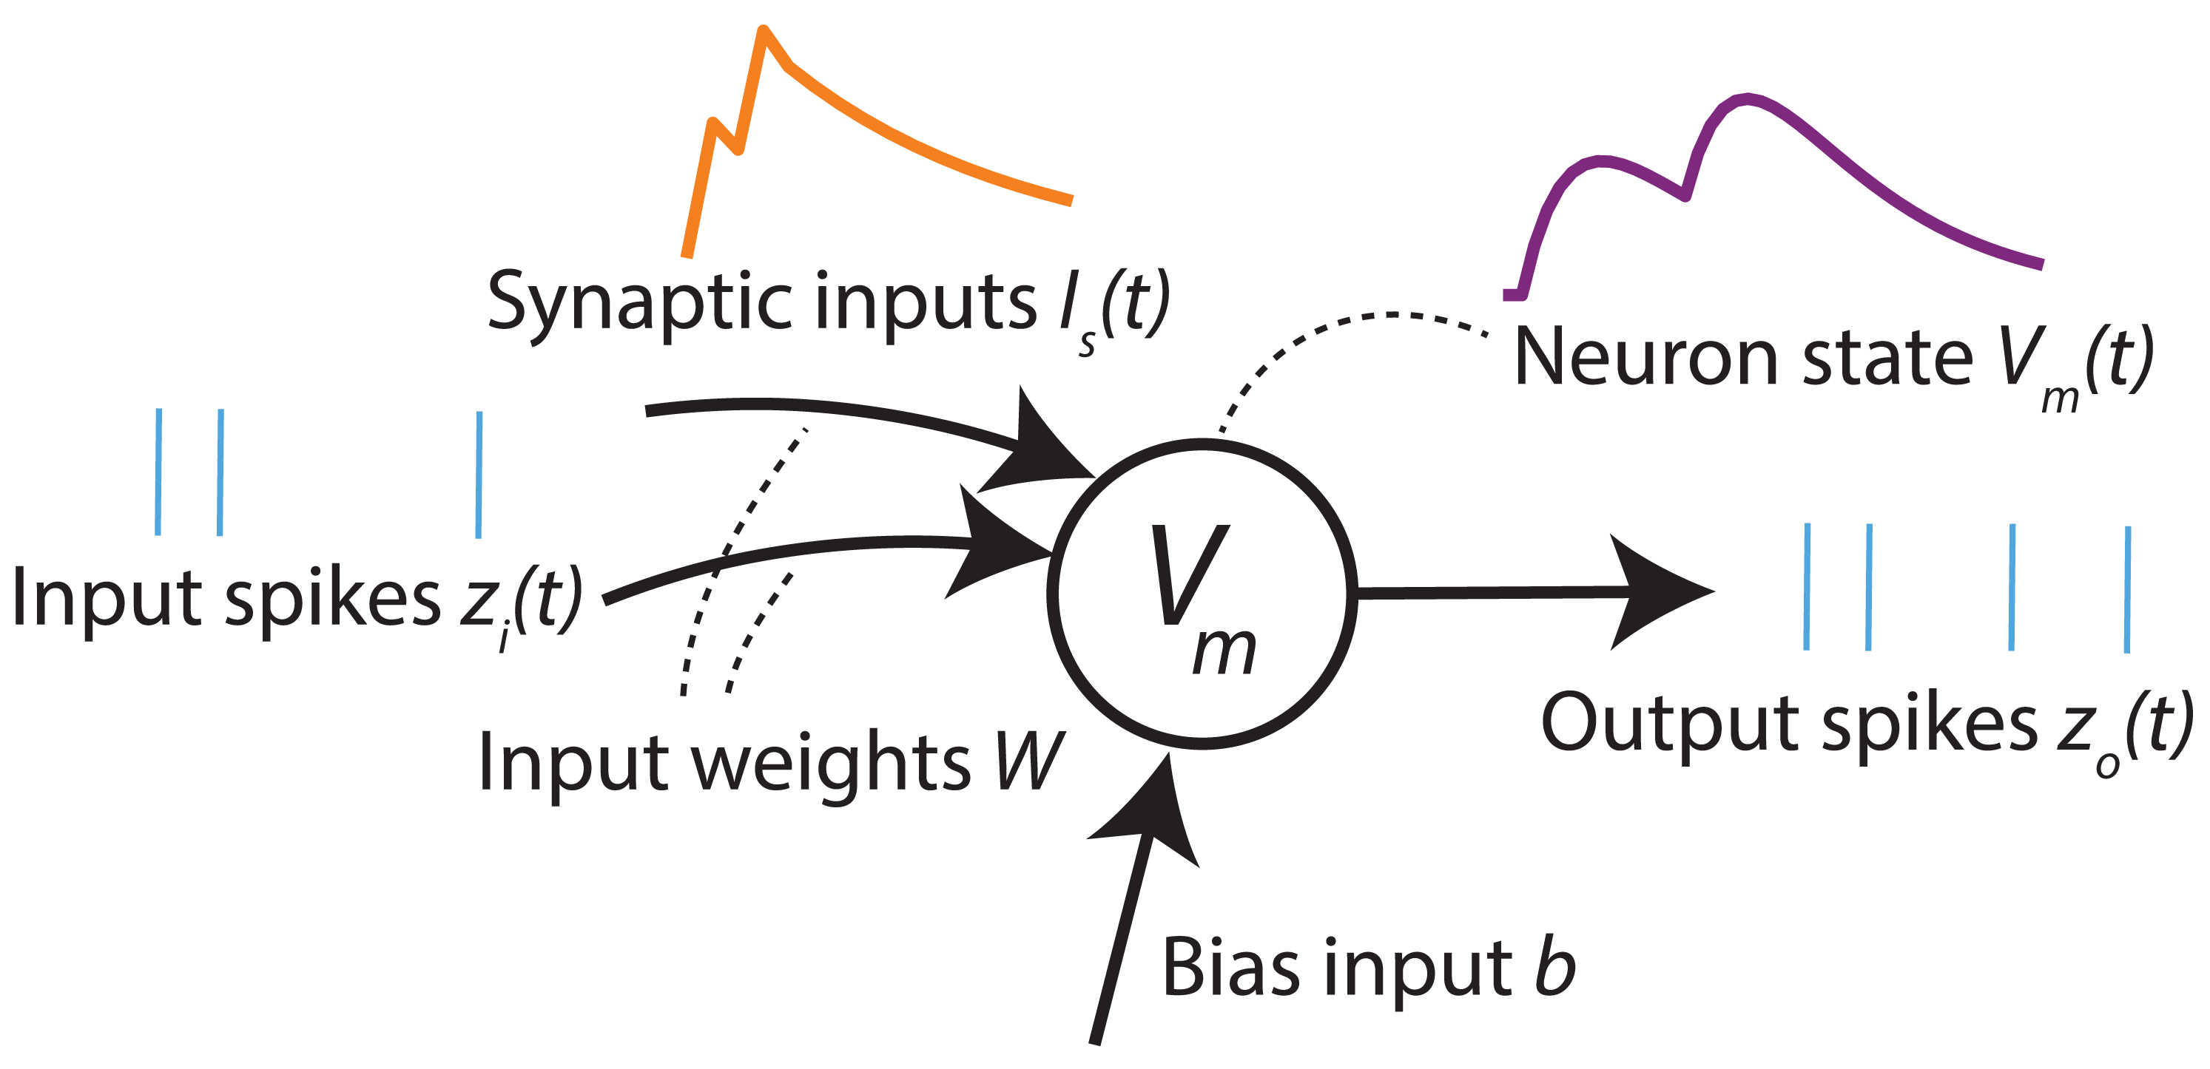
Temporal computation with SNNs

Slide 6




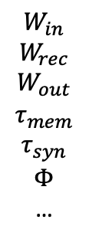
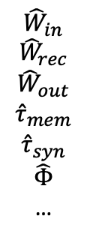
$$W_{in}$$
$$W_{rec}$$
$$W_{out}$$
$$τ_{mem}$$
$$τ_{syn}$$
$$Φ$$
…
$${\hat{W}}_{in}$$
$${\hat{W}}_{rec}$$
$${\hat{W}}_{out}$$
$${\hat{τ}}_{mem}$$
$${\hat{τ}}_{syn}$$
$$\hat{Φ}$$
…
0010010101 0001010100 1010010010 1001010101 0010101010 1110001110 0001110101
1010010010
…
Simulatable network
Trained network
Computational graph
Mapped parameters
Quantised parameters
Bitstream HW configuration
Define network
Train
Convert to graph
Map to HW architecture
Quantise parameters
Deploy to HW
rockpool.ai
Notes:
* Our application development pipeline is also available for these devices
* Python-based, supporting all steps of model devlopment, training, quanlisation and mapping to HW, and deployment to the dev kit
* These are based on industry-standard toolchains for NN training

Slide 7


Slide 8
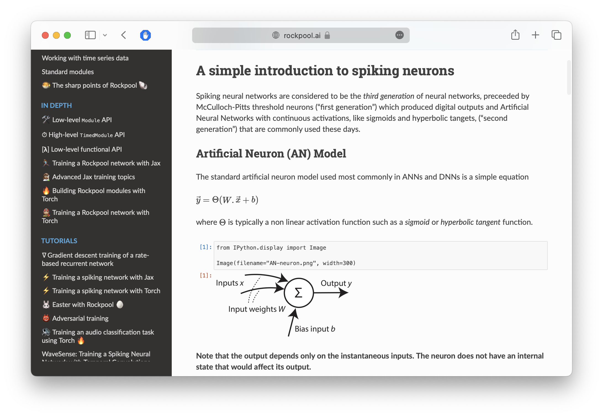

Slide 9
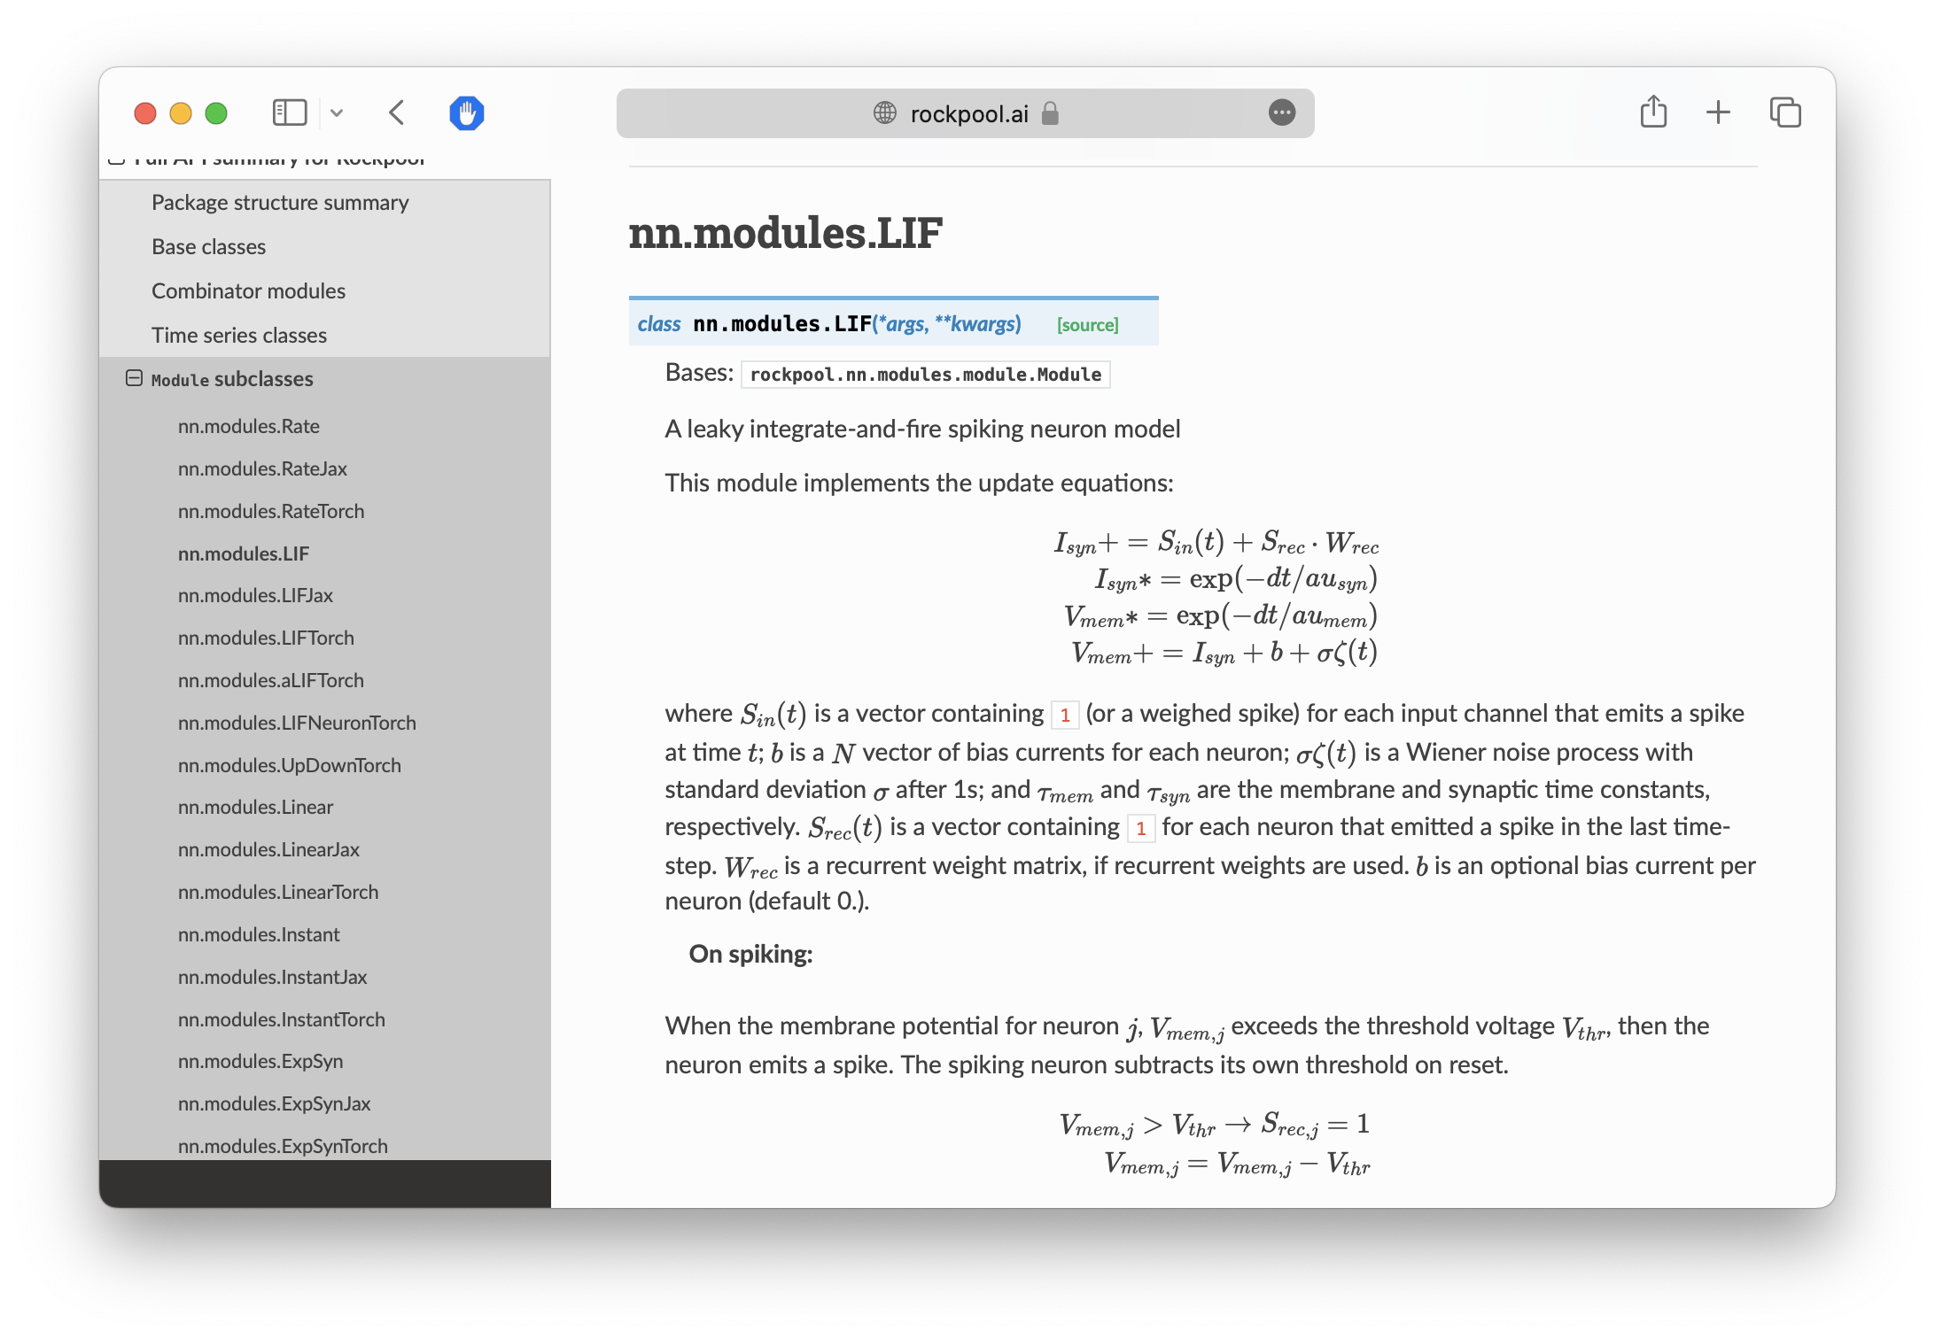

Slide 10
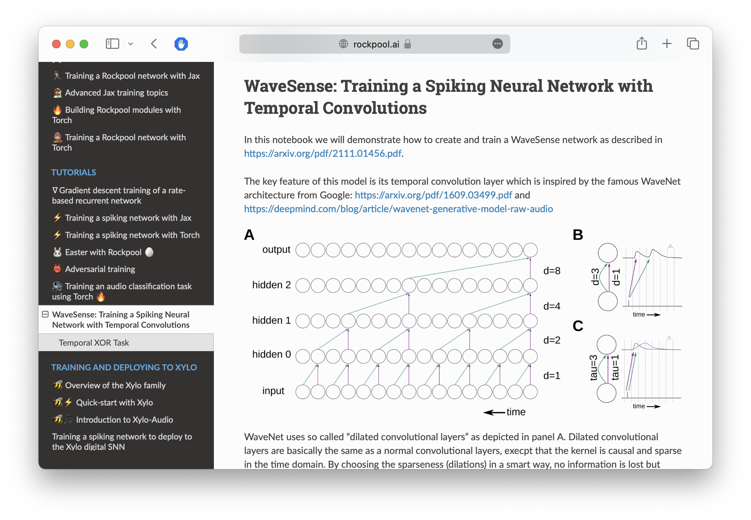

Slide 11
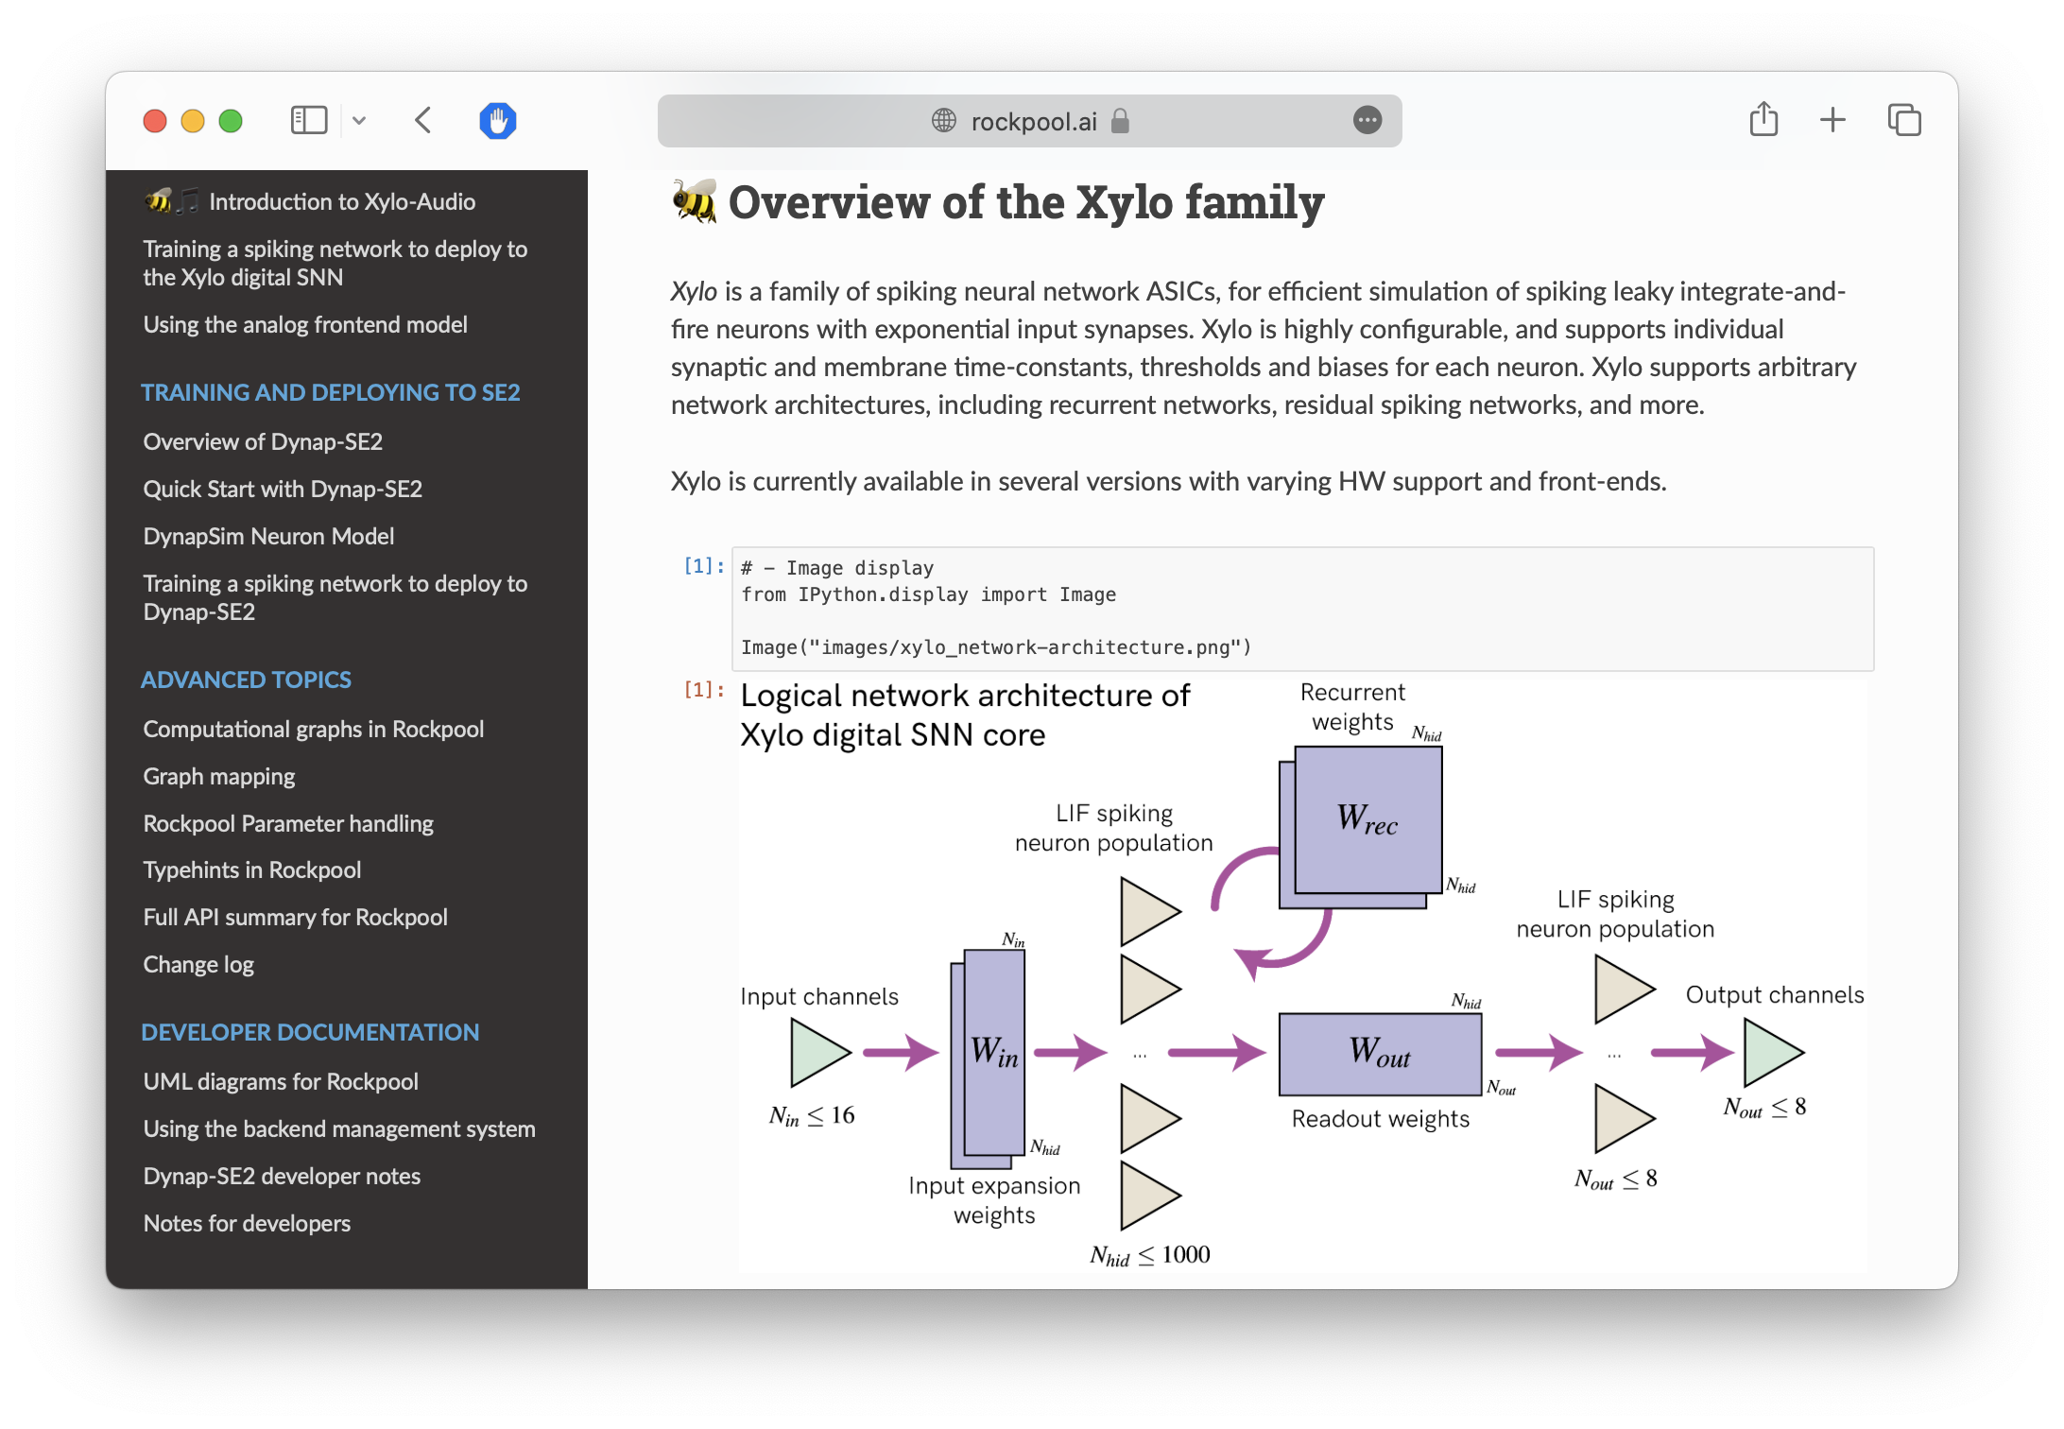

Slide 12
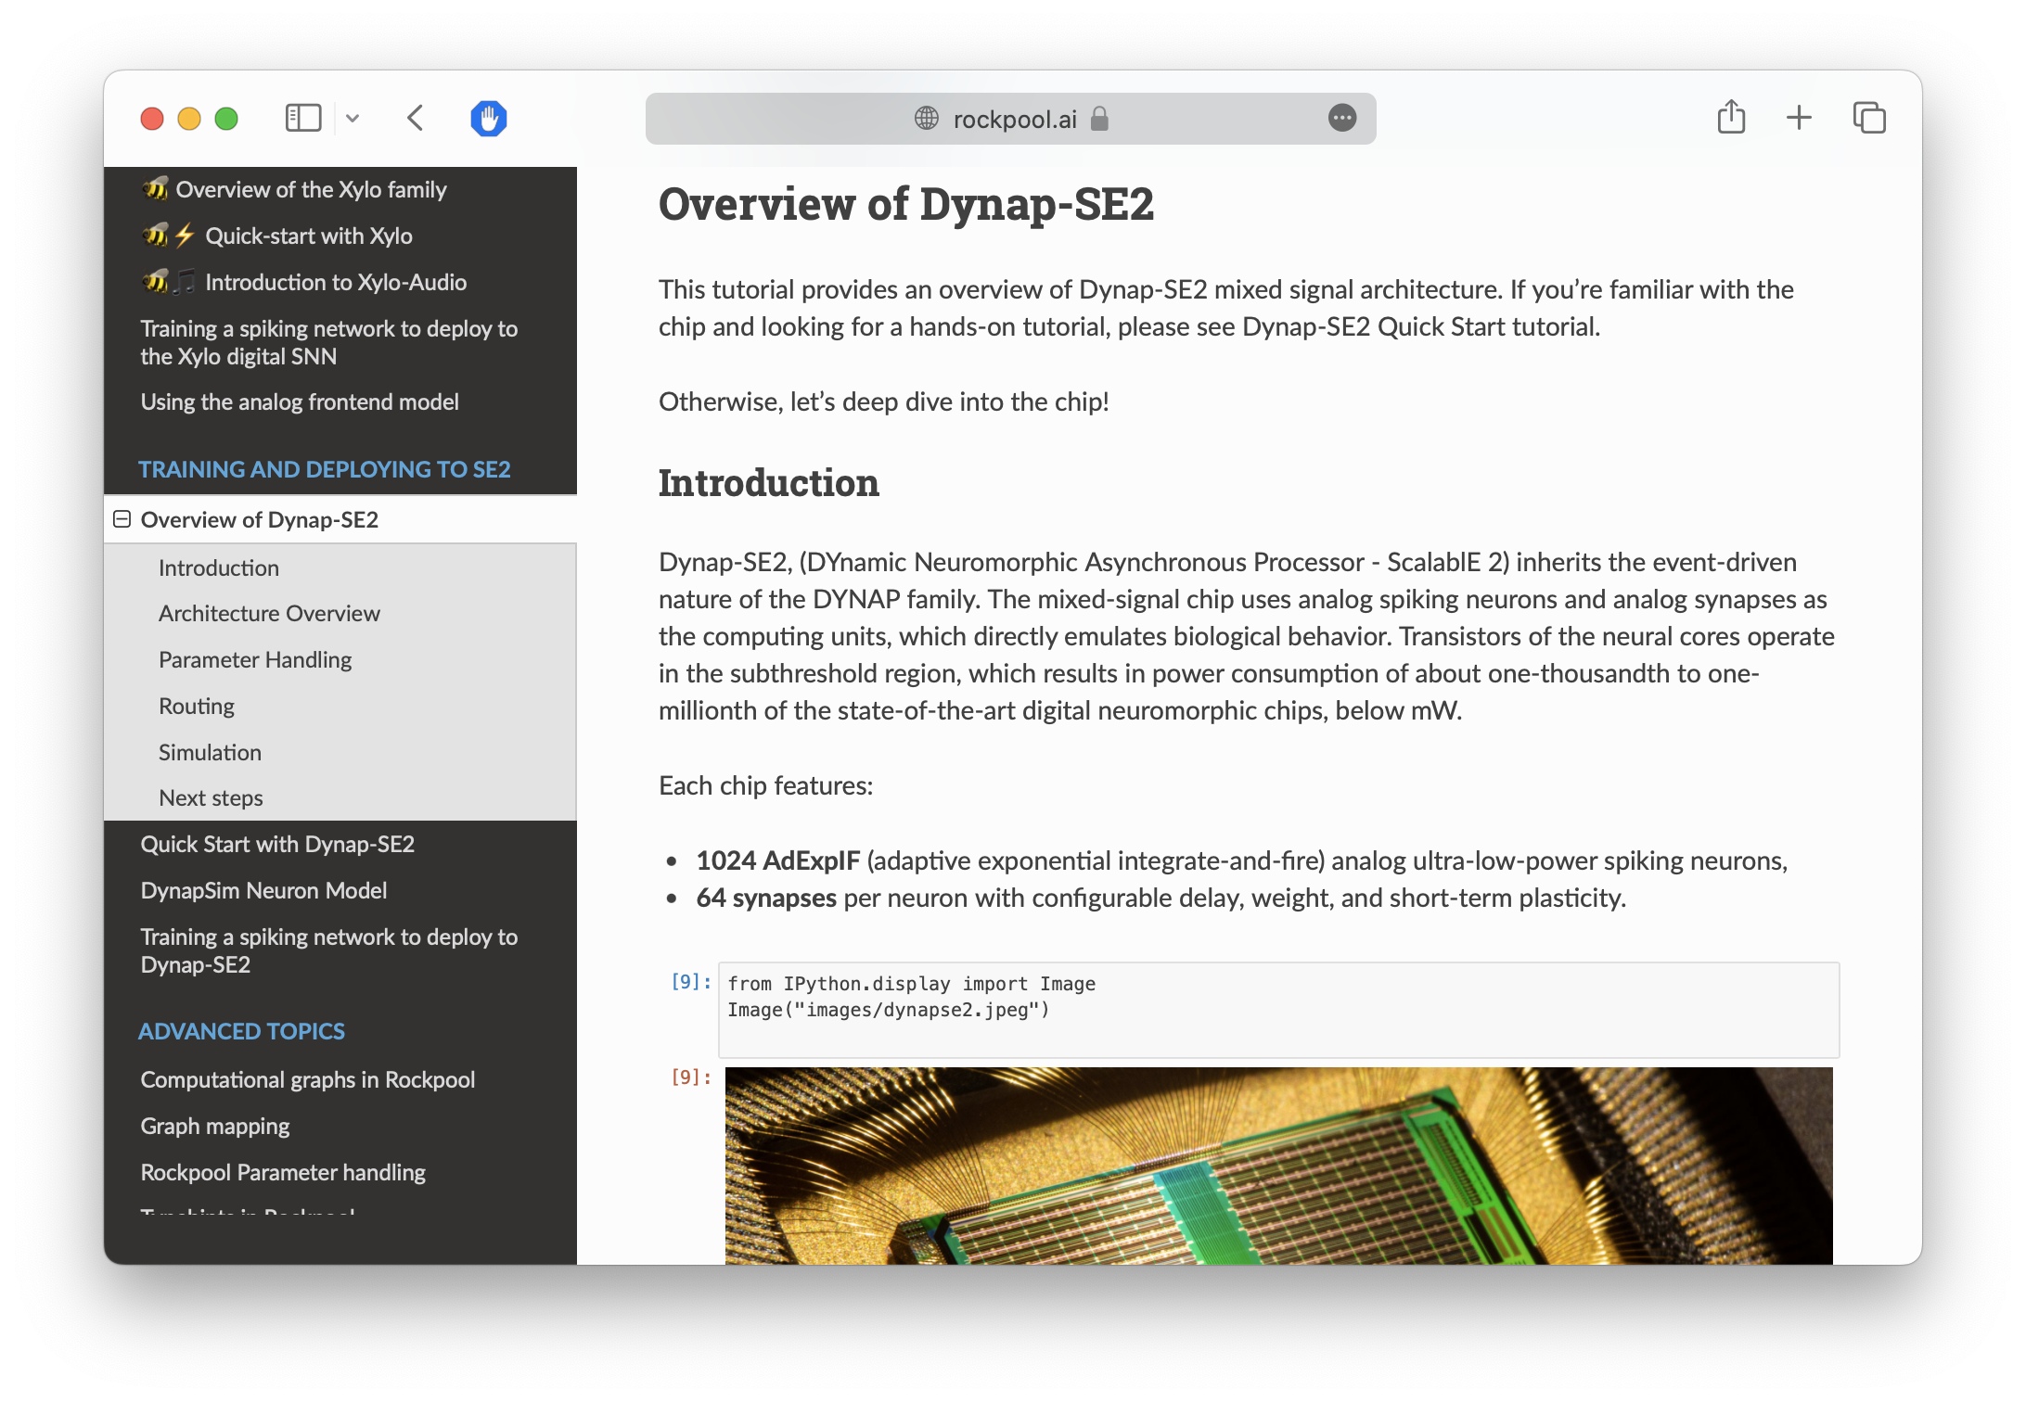

Slide 13
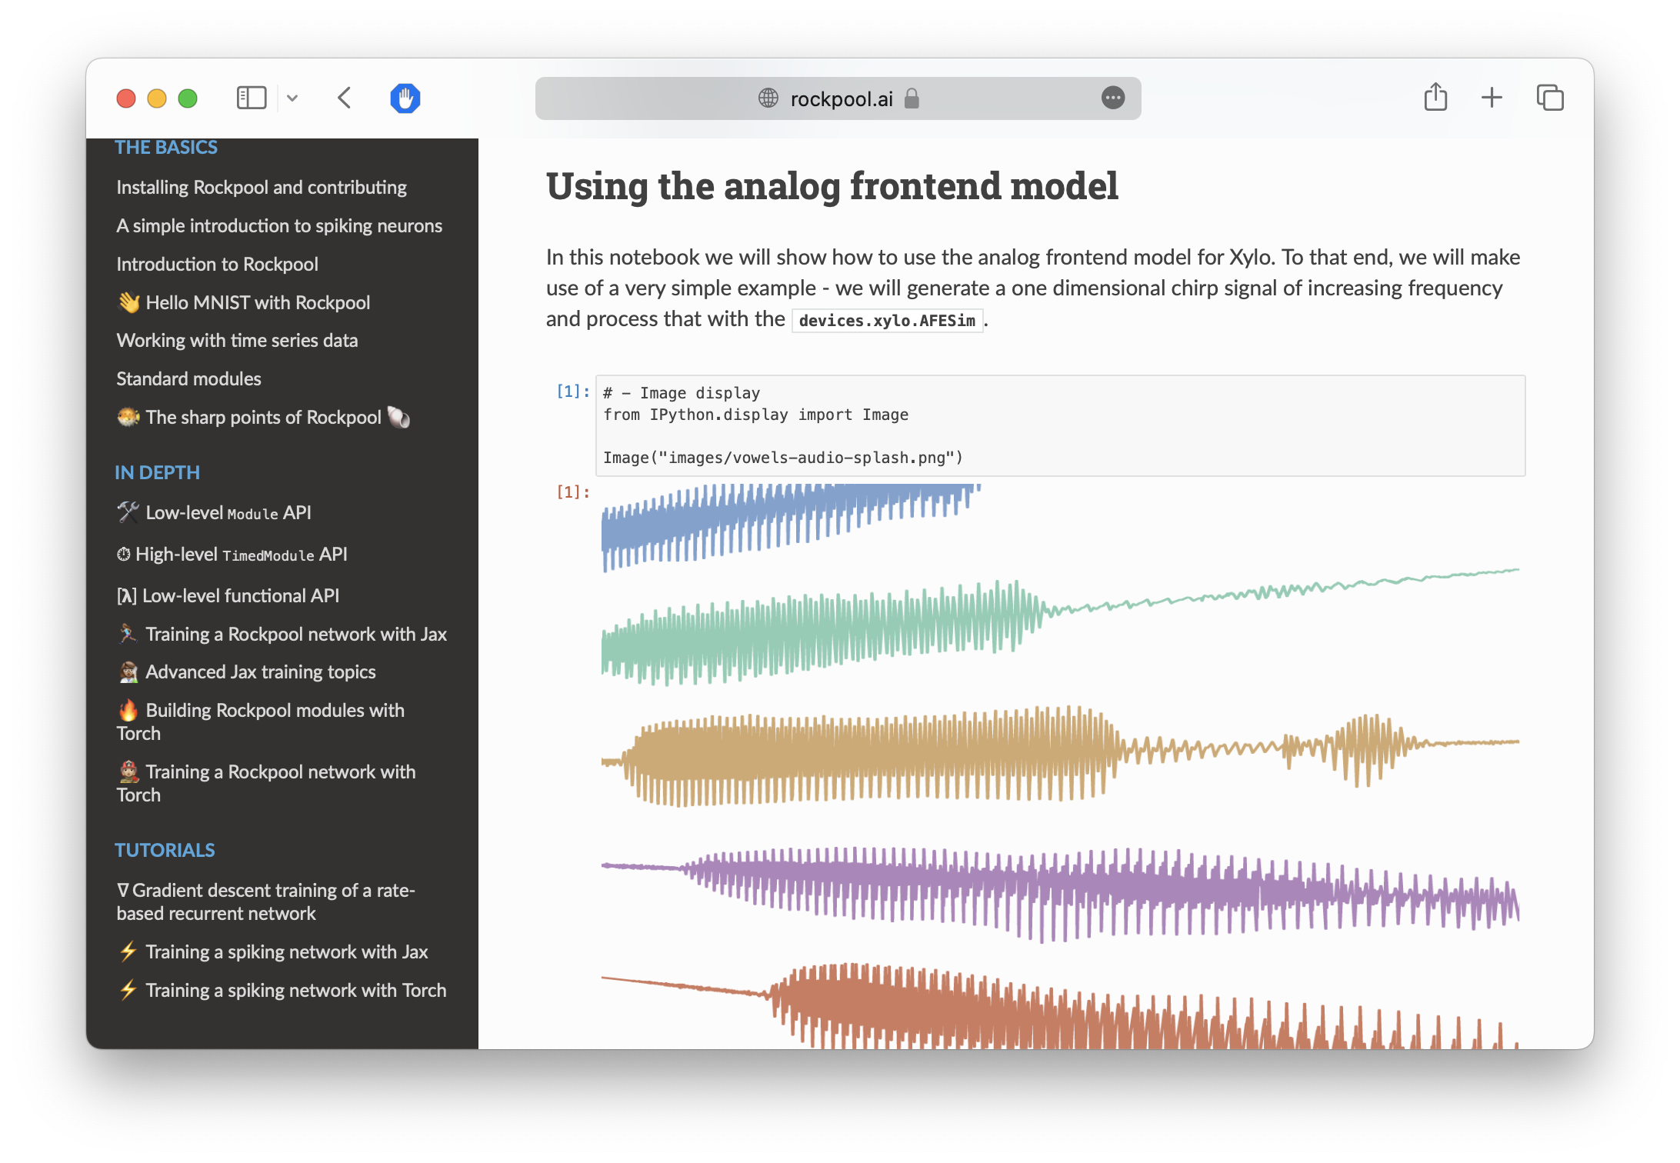

Slide 14
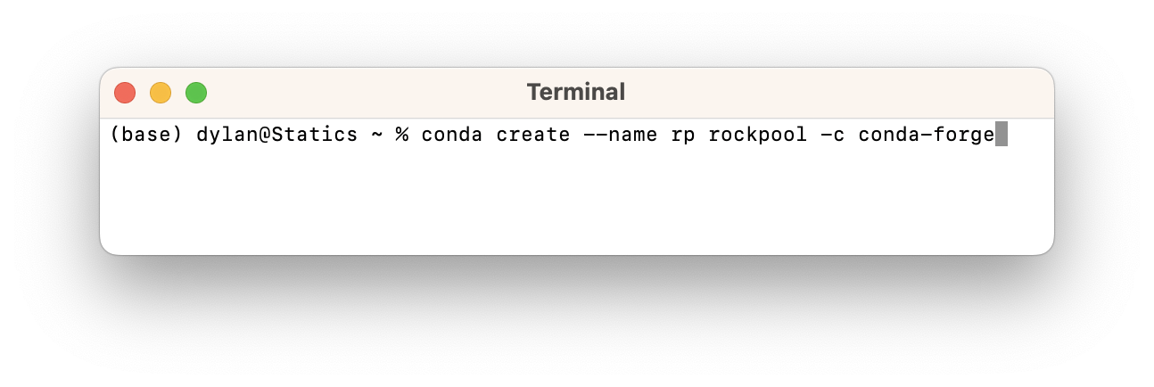
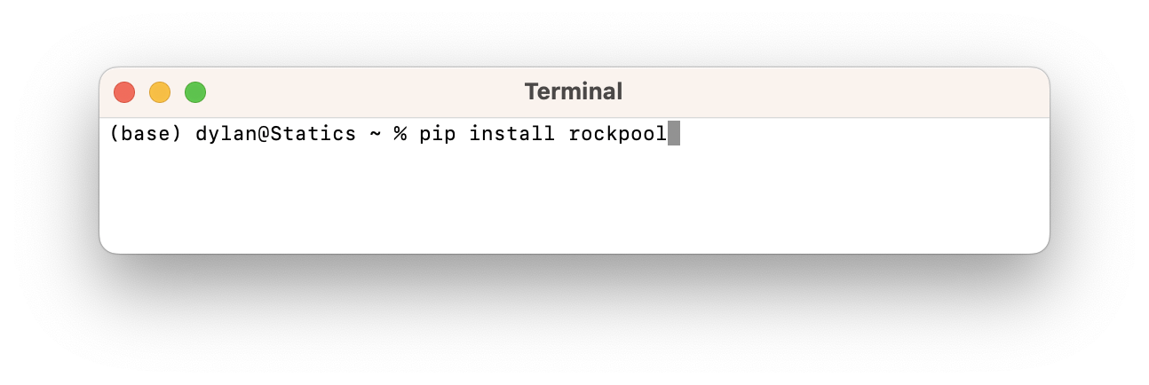

Slide 15
Steps
How to define and configure a spiking neuron
How to build a network
How to train an audio task
Deploying the network to the Xylo SNN processor

Slide 16
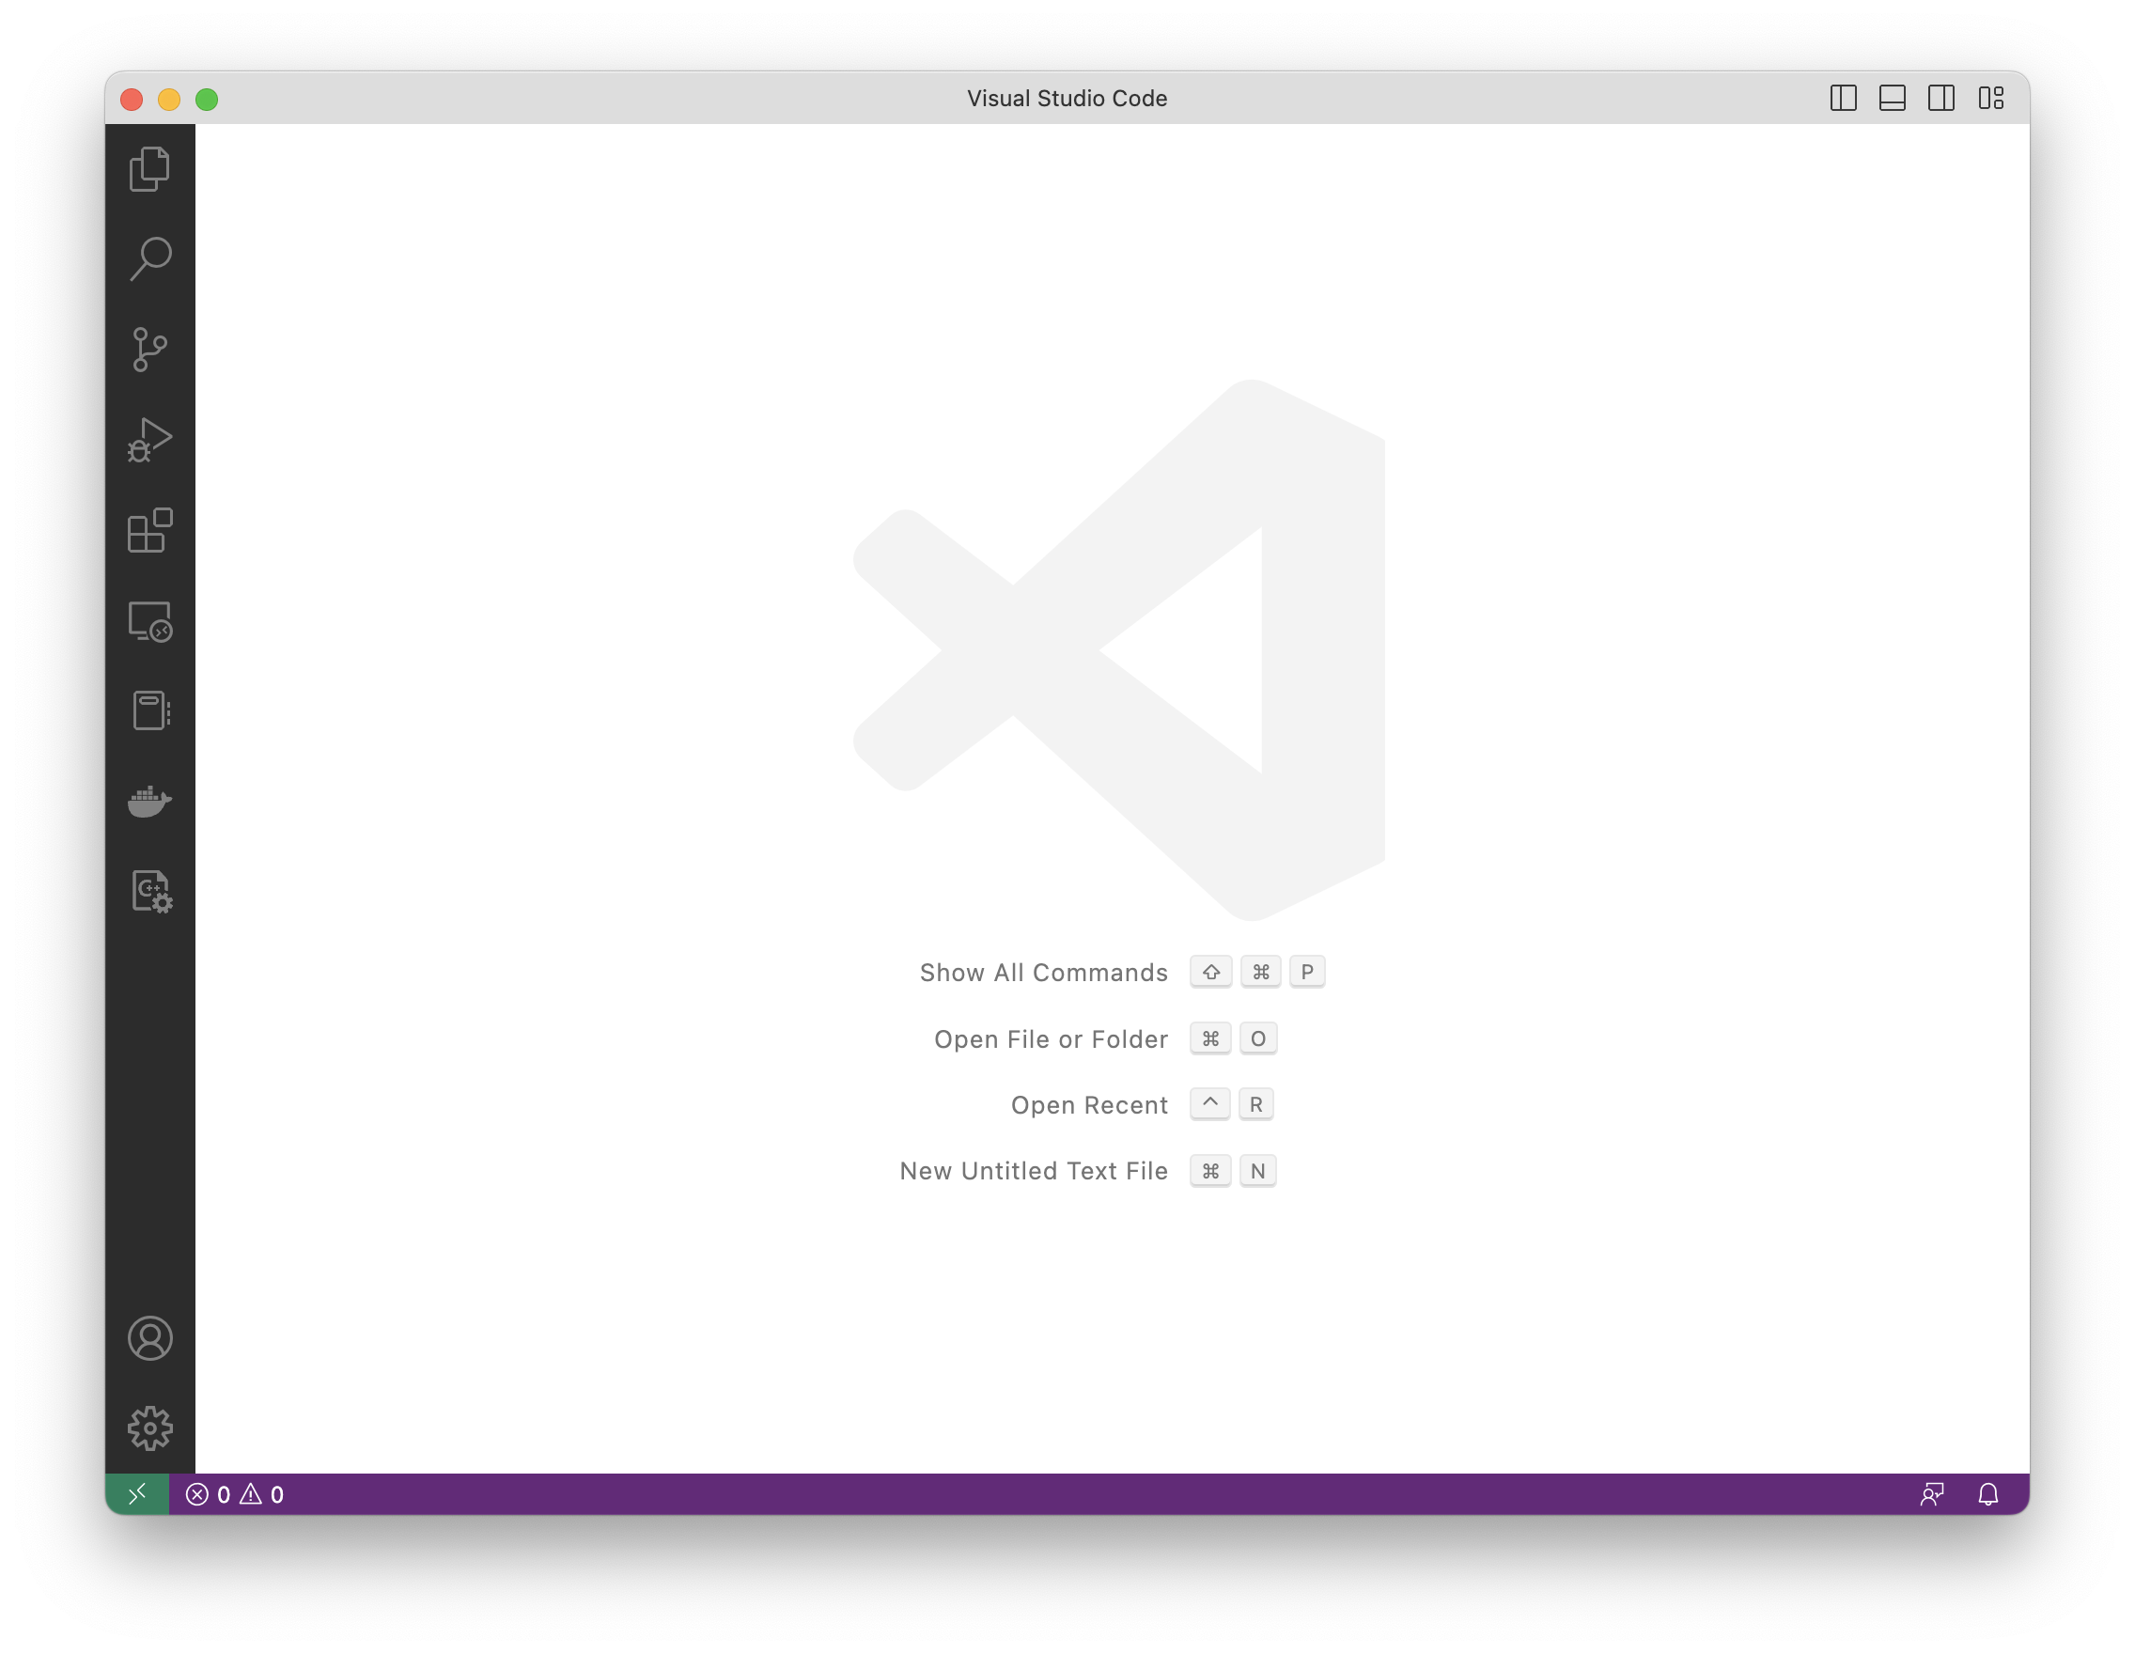

Slide 17
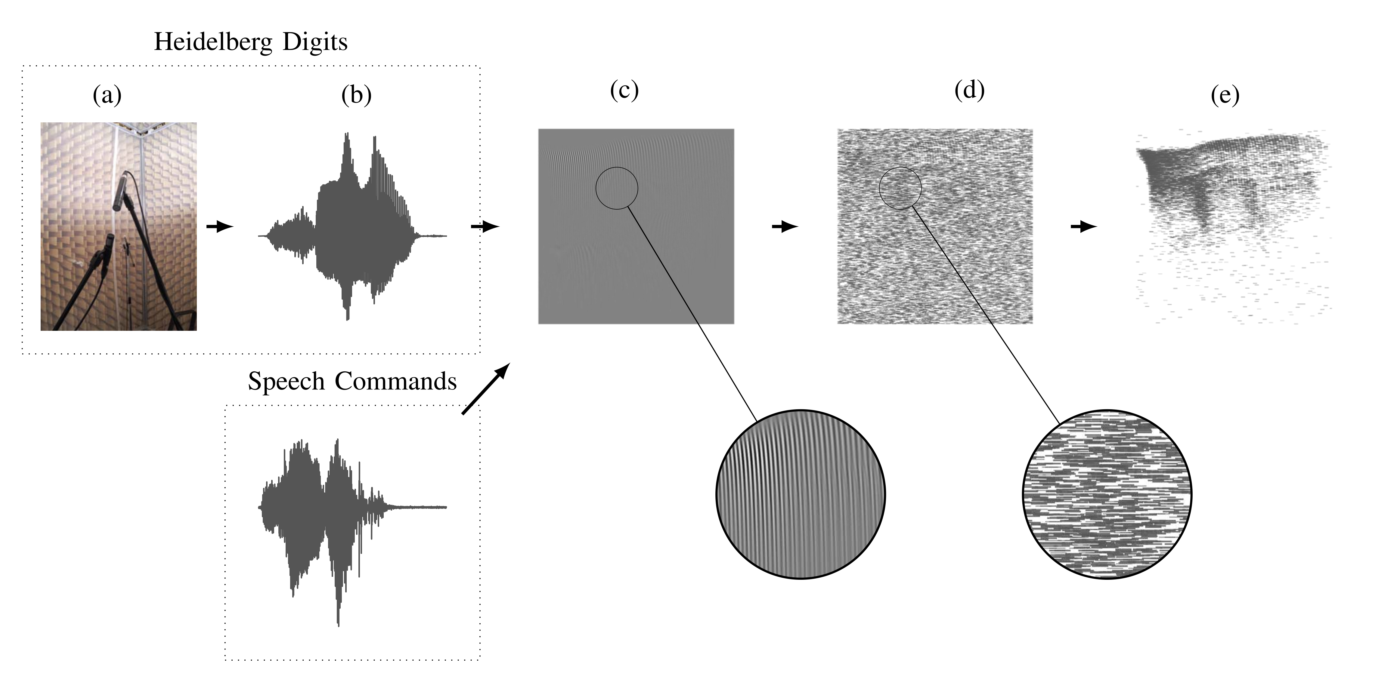

Spiking Hiedelberg Digits
Spoken digits, English and German
20 classes
Pre-processed with highly detailed basilar membrane / cochlea model
Input data provided as spike events
Cramer et al. 2022. IEEE Trans. NNLS 33 2744–2757. 10.1109/TNNLS.2020.3044364

Slide 18

Neuromorphic datasets
SHD, S-MNIST, DVSGesture, …
Data transformations
Data augmentation
Caching
Open source ❤️
…
tonic.readthedocs.io

Slide 20
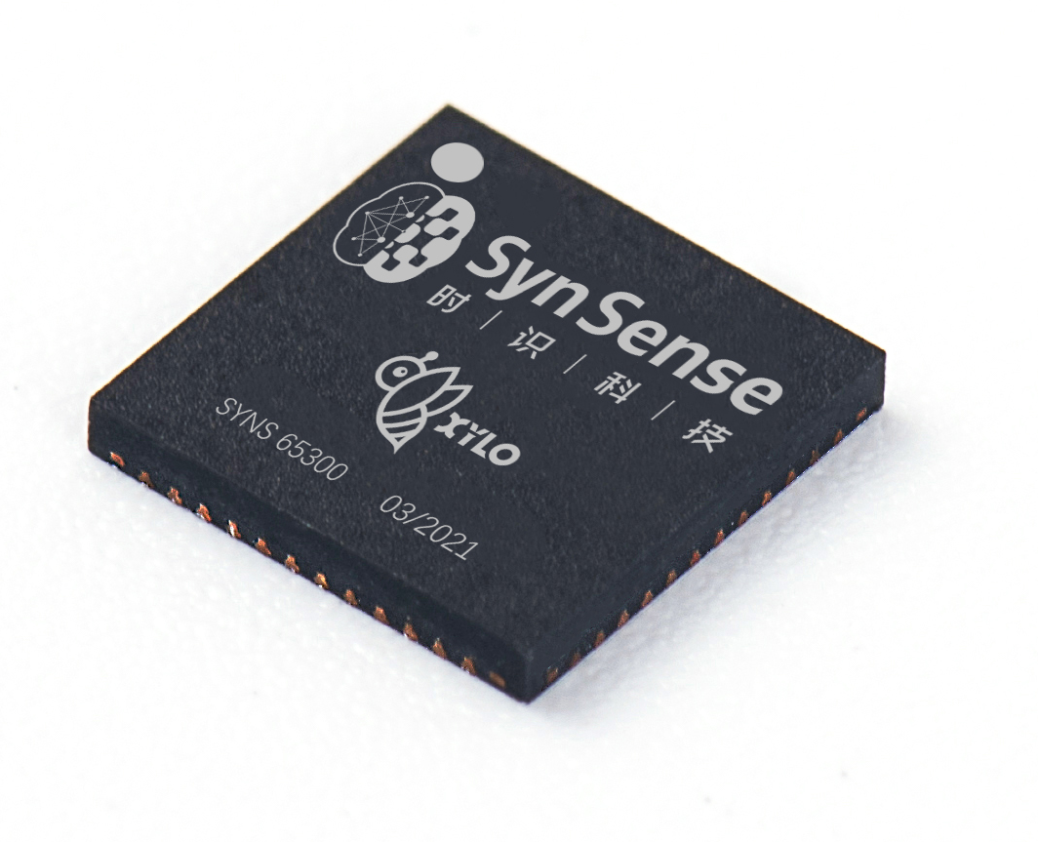
Xylo digital SNN architecture Logical network architecture
Notes:
The network implemented by the processor has this logical architecture
Up to 16 event-based input channels are supported
Linear input weights are provided for the 1000 hidden LIF neuron population
The hidden population supports recurrent connectivity
A set of readout weights are provided to an 8-neuron LIF spiking output population, producing up to 8 output channels for the chip

Slide 21
Xylo digital SNN architecture Digital LIF Neuron
Notes:
We also designed with the IC team a digital neuron tailored for temporal signal processing applications
This architecture is called “Xylo”.
I’m showing here the neuron architecture
It’s an all-digital architecture, which includes synaptic and membrane states with leak

Slide 22
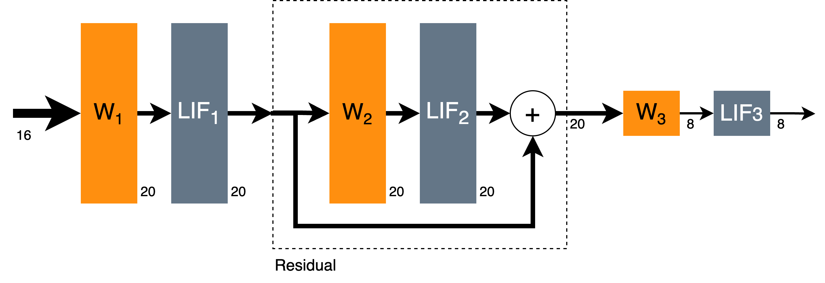
Network architecture

Slide 23
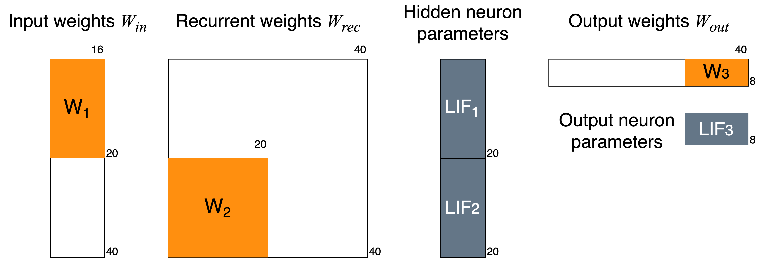
Mapping process

Slide 25

PyTorch, Jax backends
GPU/CUDA, TPU, MPS acceleration
Constrained optimization for SNNs
Time constant & threshold training
Deployable adaptive LIF models
Quantization-aware training
Mixed-signal HW-aware training
Easily extensible
Open source ❤️
…

